Slide 1

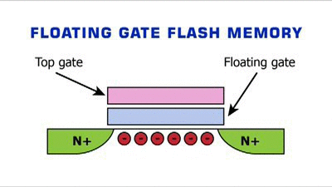


SSD VS. HDD
The main difference between an SSD and a regular harddrive; is that the ssd doesn't have any moving parts; and because of that it makes reading and writing data much faster than a mechanical hard drive.

Slide 2


HDD is like a Phonograph from back in the day and SSD is like the Modern .Mp3 player
SSD Data is instant
HDD Seeks data, -creates seek times for data
until In early 2007, when Samsung introduced its first generation SSD into the market it had a capacity of 32GB, sequential read/write speeds of 57 MB/s and 32 MB/s respectively and a hefty price tag of around $1000.

Slide 3

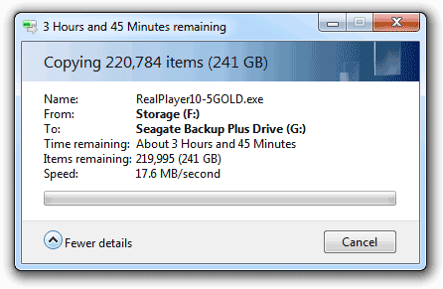

ARE SSD's FAST?
The most common HDD has an average speed of 120 MB/s , read and write speeds.
An SSD speed is about 530 MB/s read and write speeds. An SSD is 410+ MB/s faster than a HDD

Slide 4



How FAST are SDD's?
Lets say your computer took 1 min to be usable from when you first push the power button,
Now it takes 30s, and when you transfer data on it like from your phone, or an external hard drive is now much faster. USB cables transfer data at about 480-640 MB/s

